Slide 1
ICTICT451 – Comply with IP, Ethics and Privacy in an ICT environment
Week 2 – Ethics 1
K Fitzpatrick
Thursday, 20/1/2022
Our Values: Respect, Integrity, Student-centred, Accountability, Innovation, Professionalism

Slide 2
Acknowledgement of Country
North Metropolitan TAFE recognises Australian Aboriginal and Torres Strait Islander People's unique cultural and spiritual relationships to the land, waters and seas and their rich contribution to our society. We acknowledge the Noongar People, the traditional custodians of the lands on which our campuses are located, and pay our respects to ancestors and Elders, past and present.

Slide 3
Welcome
Week 2: Overview and Ethics 1
Ethics 1: ‘Ethical behaviour and Social Responsibility’
Reflect & Reinforce

Slide 4
Ethics 1 – Definitions and meaning
First, what do we mean by the term ‘Meaning’ ?
Generally speaking, we seek truth to draw benefit from meaning
Our search for truth (true or false) provides the basis for meaning (i.e. if something is untrue, then it means something, just as something is true.)
Proof is also part of this. E.g. If something can be validated or reliable, then we believe it and draw meaning from it.
Meaning follows understanding, which requires knowledge which draws on our requirement for proof and allows us accumulate wisdom
Without personal morals, ethics are meaningless.

Slide 5
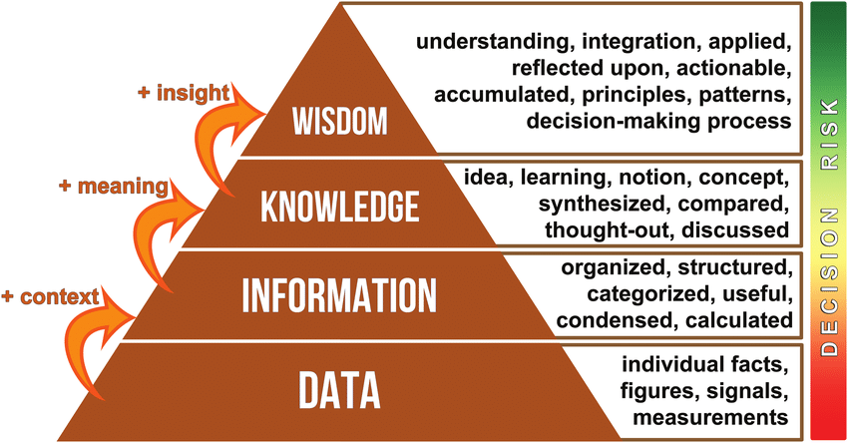
Ethics 1 – Definitions and meaning

Slide 6
Ethics 1 – Definitions and meaning
What do we mean by the term ‘Ethics’ ?
‘A system of moral principles. They affect how people make decisions and lead their lives’ (bbc.co.uk, 2022)
An set of rules imposed from an external source that determines a person or group’s behaviours
Morals are the innate principles (or values) we are imbued with as part of our upbringing (right vs wrong, etc.). Ethics pulls on our morals.
Without personal morals, ethics are meaningless.

Slide 7
Ethics 1 – Definitions and Ethical Behaviour & Social Responsibility
At the end of this session students should be able to:
Define ethical behaviour
Understand how ethical standards are achieved and maintained
Understand how ethical dilemma can occur and what they mean
Understand the concept of Corporate Social Responsibility
(Content within Ethics1 largely derived from Wiley.com ‘Understanding Ethics and Moralistic behaviour’ (Asia 7th edition), 2018)

Slide 8
What is ethical behaviour?
Ethics: set of standards as to what is good or bad, or right or wrong in a person’s conduct.
Ethical behaviour is accepted as ‘right’ or ‘good’ or ‘proper’ in the context of a governing moral code.
If an act is legal, some will proceed with it confidently, while others might believe that the ethical test goes beyond legality. This is a matter of personal values.
Values are broad beliefs about what is or is not appropriate behaviour. Sometimes referred to a Morals or Principles.

Slide 9
Alternative views of ethical behaviour (… and some ‘isms’)
There are many different interpretations of what constitutes ethical behaviour.
The utilitarian view considers ethical behaviour as that which delivers the greatest good to the greatest number of people.
The individualism (or sometimes known as Deontological) view considers ethical behaviour as that which advances long-term self-interests.
The moral-rights view considers ethical behaviour as that which respects and protects the fundamental rights of people.

Slide 10
Alternative views of ethical behaviour
The justice view considers ethical behaviour as that which treats people impartially and fairly according to guiding rules and standards.
Procedural justice is concerned that policies and rules are fairly administered.
Distributive justice is concerned that people are treated the same regardless of individual characteristics.
Interactional justice is the degree to which others are treated with dignity and respect.
Universality (or Absolutism) is concerned with the idea that facts can be progressively discovered in order to build wisdom.

Slide 11
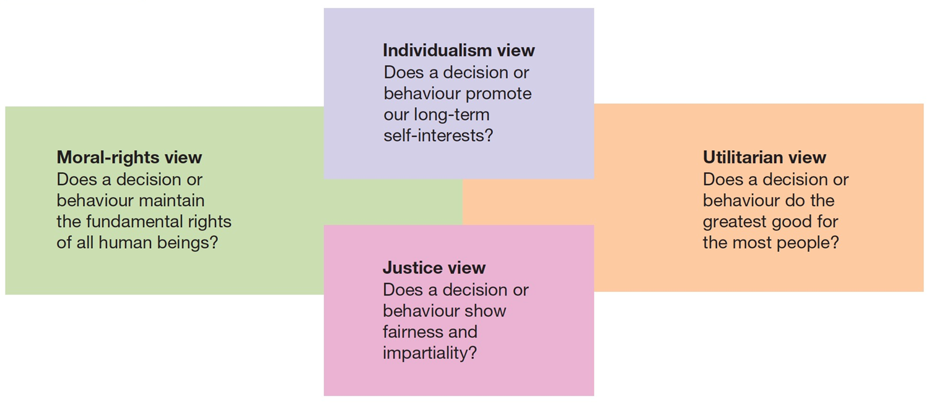
Alternative views of ethical behaviour

Slide 12
Ethics in the workplace
Factors influencing ethical behaviour:
the person — family influences, religious values, personal standards and personal needs
the organisation — formal policy statements and written rules establish an ethical climate
the environment — government laws and regulations, and social norms and values.

Slide 13
Maintaining ethical standards
Ethics training seeks to help people understand the ethical aspects of decision making, and incorporate high ethical standards into their daily behaviour.
Many ethical dilemmas arise as a result of the time pressures of decisions. Ethics training is designed to help people deal with ethical issues under pressure.

Slide 14
Simple checklist for maintaining personal ethical standards
Step 1. Recognise the ethical dilemma.
Step 2. Get the facts.
Step 3. Identify your options.
Step 4. Test each option: Is it legal? Is it right? Is it beneficial?
Step 5. Decide which option to follow.
Step 6. Double-check decision by asking follow-up questions.
Step 7. Take action.

Slide 15
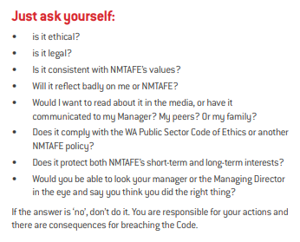
Example: NM TAFE Staff Code of Conduct
This is a pretty effective checklist ! ☺

Slide 16
Some causes for unethical behaviour
Absent or vague organisational governance (e.g. poor policy development or communication processes)
Inconsistent decision making (Boris)
Discrimination
Sexual Harassment
Conflicts of Interest

Slide 17
Rationalisation for unethical behaviour
Four common rationalisations that are used to justify misconduct:
Convince yourself that the behaviour is not really illegal.
Convince yourself that the behaviour is really in everyone’s best interests.
Convince yourself that nobody will ever find out what you’ve done.
Convince yourself that the organisation will ‘protect’ you.
When in doubt about taking an action, don’t do it. (Goto NM TAFE Staff CoC)

Slide 18
Ethical Dilemma
Remember: Ethics are the requirements demanded upon us from some external agency that pull on our Morals (our innate sense of right and wrong).
It’s easy when things are either right or wrong…
What happens when things get confusing?
NEXT WEEK: We will look at a famous ethical dilemma: ‘The Trolley Problem’ (Foot, P. & Thomson, J. (1967))

Slide 19
Week2 Summary
More into The Case Study: St Bert’s Healthcare Ltd
Formed groups yet ?(for AT2)
Began with some definitions of ethics and how they matter in the ICT context
Introduce the notion of the ethical dilemma (the topic for next two weeks)

Slide 20

That’s it for this week!
Remember to email me with any questions on
Keith.fitzpatrick@nmtafe.wa.edu.au
5/08/2023
VISION: Transforming lives; strengthening industry and community.
20

